Slide 1
Hope Foundation’s Finolex Academy of Management and Technology, Ratnagiri Department of Information Technology Structured Network Design for a Departmental Shop Kazi Jawwad A Rahim Kiratkar Gunjan Narayan Ghadage Sahil Shrirang Guided By: Mr. Atul B. Yadav

Slide 2
Contents
Introduction
Proposed System
Objectives
Prepare Phase
Plan Phase
Design Phase
Implement Phase
Operate Phase
Optimize Phase
Conclusion
References

Slide 3
Introduction
Need of wireless network
CISCO
Components in network
Departmental Store Network

Slide 4
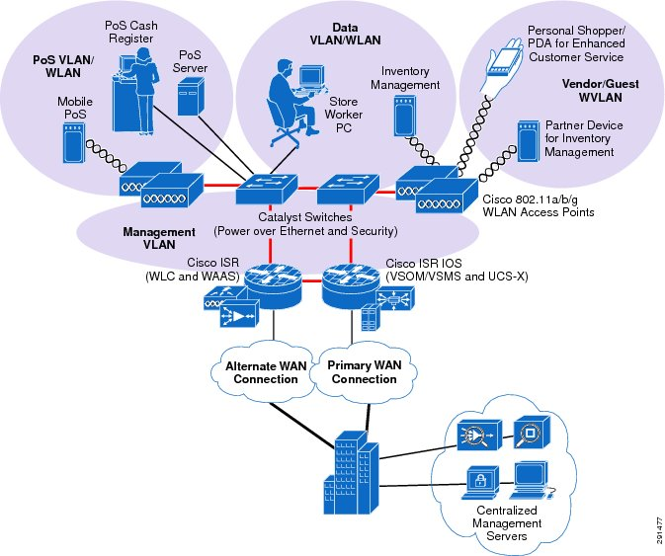
Proposed System
Fig. Proposed System for Store Network

Slide 5
Objectives
To provide networks services to Departmental Store
To provide data security to Departmental Store
To provide network security to Departmental Store
To provide ease of business to Departmental Store

Slide 6
Prepare Phase
Organizational Goals
Network Design Strategies
Technology Used and Budget

Slide 7
Plan Phase
Network Service used in store
Gap Analysis

Slide 8
Design Phase
Requirement Gathering Technique
Router Configuration
Authentication Mechanism
Design Principles

Slide 9
Implement Phase
Involve the right people and build a powerful team
Define professional goals and develop the solution configuration
Integration and testing
Training, Pilot Stage and Go-Live
Implementation

Slide 10
Operate Phase
Router fault detection
Performance Monitoring

Slide 11
Optimize Phase
Not making enough money
Consumer expectations
Increasing competition from financial technology companies
Regulatory pressure
Evolving competition in the retail store marketplace
Customer-driven transformation of retail marketing services
Virtualization of IT infrastructure
The continuous yet ever-changing challenge of regulatory compliance
A network built for change

Slide 12
Conclusion
Followed the guidelines specified by CISCO
Requirement gathering is done with feasibility study
Waiting for client’s response

Slide 13
References
[1] Design Zone for Enterprise Networks - Cisco
https://www.cisco.com/c/en/us/solutions/design-zone/networking-design-guides.html
[2] Cisco PCI Solution for Retail 2.0 Design and Implementation Guide - Solution Implementation [Design Zone for Retail] - Cisco
https://www.cisco.com/c/en/us/td/docs/solutions/Verticals/PCI_Retail/PCI_Retail_DIG/ch4_PCI.html
[3] Cisco PCI Solution for Retail 2.0 Design Guide - Solution Architecture [Design Zone for Retail] - Cisco
https://www.cisco.com/c/en/us/td/docs/solutions/Verticals/PCI_Retail_DG/PCI_Retail_Design_Guide/ch3_PCI.html
[4] Network Architecture & Design Store
http://www.ciscopress.com/store/browse.asp?st=42136
[5] 5 Wireless Network Design "Best Practices" for Retail
https://www.securedgenetworks.com/blog/got-slow-wifi-learn-5-wifi-design-for-retail-best-practices
[6] Logical Network Layout for Small Networks - Simple Talk
https://www.red-gate.com/simple-talk/sysadmin/general/logical-network-layout-for-small-networks/
[7] Retail Network Infrastructure Security Keeping Customers Safe
https://isg-technology.com/news/retail-network-security-customers-business-safe/
[8] Key Considerations To Build A Scalable Retail Network Infrastructure - Retail TouchPoints
https://www.retailtouchpoints.com/features/executive-viewpoints/key-considerations-to-build-a-scalable-retail-network-infrastructure
[9] Building Enterprise Network Infrastructure for a Supermarket Store Chain: Computer Science & IT Journal Article | IGI Global
https://www.igi-global.com/article/building-enterprise-network-infrastructure-supermarket/3237
[10] Retail Industry Networking Security Solutions Aruba
https://www.arubanetworks.com/solutions/retail/

